Slide 1
East Renfrewshire Soccer
Development Association
Small-Sided Games
Season Guide 2026
v. 19_2_25

Slide 2

ERSDA small-sided game
Dear all,
At ERSDA, our ambition is simple: to create the best possible football development environment for our young players. We follow the National Player Pathway and operate under the rules and regulations of the SYFA and SWF, while embracing the “Let Them Play” philosophy to ensure a positive, player-first experience.
This Season Guide outlines what that means in practical terms for 2026, including:
Fixtures, scheduling, and team availability – how we plan to structure games.
Matchday environment – ensuring a safe, enjoyable experience for all.
Game formats – age-specific adaptations and key playing details.
Venue organization – how age groups will be structured across locations.
In partnership with ERCL, ERSDA is run entirely by volunteers, and success depends on everyone working together—clubs, teams, supporters, and players alike. Whether you're on the pitch, the sidelines, or behind the scenes, your role matters.
Let’s make Season 2026 a great one—together!
The ERSDA Committee

Slide 3
Contacts
Role / Source | If you are looking for… | Contact details
ERSDA website | ERSDA documentation, team templates and fixture information | https://ersda.uk
ERCL website | Pitch booking and availability and venue information | https://www.ercultureandleisure.org/sports-arts/sports-pitches/
ERSDA Secretary | Team registrations and permits | Roslynn Davidson – secretary@ersda.uk
ERDSA Vice President | Referee and match official queries | Andy Robertson – vicepresident@ersda.uk
ERSDA Treasurer | Invoicing and team fees | Alan Hay – treasurer@ersda.uk
ERSDA Child Protection Officer | Player wellbeing and PVG-related enquiries | Nikki Winning – childprotectionofficer@ersda.uk
ERSDA Saturday Match Secretary | Boys/mixed match day incident reporting and small-sided game enquiries | saturdaymatchsecretary@ersda.uk
ERSDA Sunday Match Secretary | SWF fixturing, match day incident reporting and new team enquiries | Roslynn Davidson –secretary@ersda.uk
Age Group Coordinators | 2020 fixtures and scheduling enquiries | Roslynn Davidson - coaches only – via age group WhatsApp
 | 2019 fixtures and scheduling enquiries | TBC - coaches only – via age group WhatsApp
 | 2018 fixtures and scheduling enquiries | Kevin McCarron - coaches only – via age group WhatsApp
2017 - age group coordinator | 2017 fixtures and scheduling enquiries | Chris Rose- coaches only – via age group WhatsApp
2016 - age group coordinator | 2016 fixtures and scheduling enquiries | Vikram Vasudeva- coaches only – via age group WhatsApp
2015 - age group coordinator | 2015 fixtures and scheduling enquiries | Claire Dingwall- coaches only – via age group WhatsApp
2014 - age group coordinator | 2014 fixtures and scheduling enquiries | Ross Morrin- coaches only – via age group WhatsApp
ERCL Support | Coach advice and education; matchday coordinator enquiries | John Gervaise - John.Gervaise@enjoyeastren.org Iain McFarlane – Iain.McFarlane@enjoyeastren.org

Slide 4
Fixtures and Scheduling
The Season Planning Approach
Managing Changes to Game Availability
Confirming Games as “on” or “off”

Slide 5
Season Planning Approach
Fixtures in advance – 4-5 weeks at a time
In Season 2026, we are continuing to use 6-block fixture schedules, with each block covering 4-5 weeks of pre-planned fixtures. This response received positive feedback last season by giving greater visibility of fixtures, allowing teams to plan ahead.
How It Works
Each fixture block is issued in advance, providing clarity on schedules.
Fixtures will be fixed within each block—age group coordinators will not be able to adjust week-on-week based on team availability. Fixture swaps may be possible with sufficient notice, but:
  Requests must be made at least 4 days in advance.
  Changes depend on agreement from all affected teams.
  Swaps are not guaranteed due to limited pitch capacity.
Why This Approach?
Massive scheduling task – In Block 1 alone, c.285 teams will play over 1500 fixtures over 5 weeks.
High pitch utilization – We’re operating at 99% pitch capacity, making flexibility difficult.
Fairness & transparency – All clubs receive the same fixture information at the same time, ensuring an even playing field.
How Fixtures Will Be Shared
WhatsApp (age group coordinators)
We appreciate everyone’s cooperation in making this system work—it ensures smoother planning, better matchday experiences, and fair scheduling for all teams.
Block 1 – 4 rounds
7/3/26 – 29/3/26
Block 2 – 4 rounds
25/4/26 – 24/5/26
Block 3 – 4 rounds
30/05/26 – 21/6/26
Block 4 – 4 rounds
15/8/26 – 06/9/26
Block 5 – 5 rounds
12/9/26 – 25/10/26
Block 6 – 5 rounds
31/10/26 – 29/11/26
Non-Playing Weekends
April– 4th/5th; 11/12th,18th/19th
May– 23th/24th
June– 27th/28th
No games in July
August– 1st/2nd; 8th/9th
September– 26th/27th
October– 10th/11th; 17th/18th

Slide 6

Managing Changes to Game Availability
Making sure that everyone knows what is happening
Matchday Guidelines
Before Matchday
If your team is unable to fulfill its allocated fixture, please notify your fixture coordinator as early as possible. They will:
  Explore fixture swaps if feasible.
  Arrange an alternative fixture for your opponents if your team is unavailable.
On Matchday
If unforeseen circumstances delay your team or prevent attendance, the team secretary should immediately:
Post a status update in the age group WhatsApp group.
Inform opposition teams and coordinators, allowing them to manage the players present.
No-Show Policy
If a team fails to attend a fixture without prior notice, ERSDA will follow up with the club secretary to review the situation.
Teams should expect to have to miss a future match day as a consequence of not showing up and not letting anyone know in advance

Slide 7
Confirming Games as “on” or “off”
Determining whether pitches are playable can be challenging, but our priority is always to get games played where possible while ensuring player safety and following the protocols set by our pitch provider (ERCL).
For Season 2026, we will adopt the following approach to confirming suitable playing conditions:
Our commitment is to balancing fairness, safety, and playability, ensuring that decisions are made transparently and in the best interests of all involved.
Part 1 – ERCL inspection
Before 5pm on a Friday night, ERCL will inspect pitches, and confirm the status of pitches via the ERCL website and X account
If the pitches are declared OFF on Friday, then they will definitely be off on the Saturday/Sunday.
If the pitches are declared ON by ERCL on a Friday, there will be no further update until Saturday morning.
Part 2 – Making the call at game time
Whilst we hope all fixtures will remain on after a Friday inspection, we will apply 3 playability tests to each game:
Is the pitch safely playable?
Will the pitch be unduly damaged by further play?
Are the weather conditions tolerable for safe grassroots play?
We will strive to apply these tests consistently across venues. If conditions change during the morning of fixtures, and games become unplayable, the earliest possible notice of cancellation will be given to all teams yet to play via a WhatsApp age group message.
On game day, consider fixtures ON unless informed otherwise

Slide 8
Matchday environment
Creating a safe and positive matchday
Matchday behaviour charter
Team Obligations
Reporting Discrimination
5, 7 and 9-a-side pitch set up
Support from matchday coordinators
Managing matchday logistics

Slide 9
Ensuring a Safe and Positive Matchday
Charter, Pitch Guidance, Disciplinary Follow-Up and Matchday Coordinators
For Season 2026, we are committed to ensuring a safe, positive, and enjoyable matchday experience for all. To achieve this, we will be following these key principles:
1. Matchday Charter
All coaches and supporters are expected to read and follow the ERSDA Matchday Charter (see next page).
2. Supporter & Pitch Setup Guidelines
  4-a-side games: Supporters must remain outside the cages at Pro-Soccer and Woodfarm.
  5, 7, and 9-a-side games: Teams must follow the pitch set-up (outlined later in this guide), based on SFA good practice guidelines.
3. Matchday Coordinators & Matchday Reports
Each venue will have an ERSDA Matchday Coordinator responsible for:
  Observing that the Matchday Charter & pitch arrangements are consistently followed.
  Preparing a Matchday Conduct Report, noting both positive sporting moments and any issues.
Anyone attending a match can also provide feedback by emailing:
  📧 saturdaymatchsecretary@ersda.uk
  📧 secretary@ersda.uk
4. Responsibility for Conduct & Disciplinary Approach
Clubs are responsible for ensuring the appropriate conduct of their coaches and supporters.
While the vast majority of ERSDA games were incident-free last season, there were exceptions where coach or supporter behaviour was unacceptable.
When incidents are reported:
  ERSDA will follow up with club and team secretaries of those involved.
  The ERSDA Disciplinary Committee will record events and responses, and may impose sanctions depending on the nature of the incident.
  Repeat offenses may be escalated to the SYFA for further action.
  All actions will follow SYFA disciplinary procedures.
We hope never to need these measures, but we will apply them consistently if required. It is important that all clubs understand these expectations before the season begins.

Slide 10

ERSDA Matchday Behaviour Charter
The standards to which we’ll hold ourselves during games
We pride ourselves on working together to create a positive environment for our young people to enjoy their football. So there is no doubt as to what that means, we’ve drawn on the SFA’s “Let Them Play” guidelines to make a match day charter for coaches and supporters. Thank you in advance for helping us put it into practice.
Coaches
Have the well-being, safety and enjoyment of players as a top priority
Never tolerate any form of bullying or abuse
Help players improve with feedback and coaching, not making all their decisions for them
Encourage fair play & high standards of behaviour
Always show respect to everyone involved in the game
Respect the decisions of other coaches
Don’t gloat or antagonise the opposition
Don’t address opposition players or supporters not adhering to the code of conduct – leave that to the opposition coaches
Remind fellow coaches and supporters from your team only of their obligations if matters get heated
Absolutely no use of swearing or abusive/ threatening language
Supporters
When spectating, stay in the designated supporter area for your pitch facility
Applaud good play and celebrate if a goal is scored
Let the players play – its their game
Be a role model for your player in how you talk and act around the game
Respect the coaches’ decisions & don’t shout at them – without them volunteering there would be no game
Don’t approach any member of the opposition coaches, players or supporters at any point with aggression or negativity
Don’t shout instructions – the team already has a set of coaches
Try to have fun and enjoy watching your player play
Absolutely no use of swearing or abusive/ threatening language

Slide 11
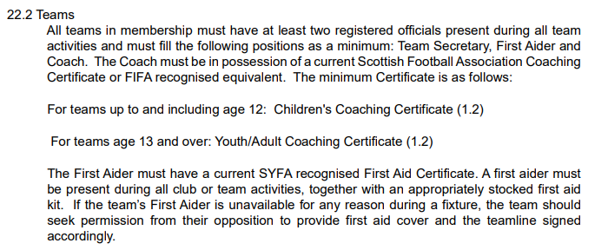
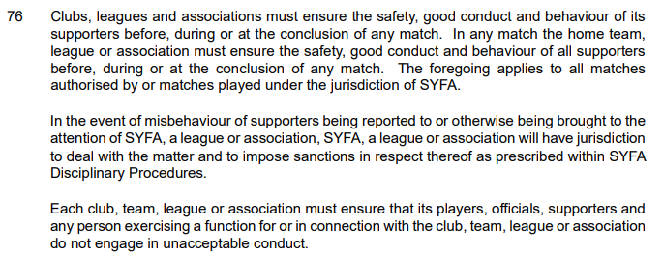
Important Team obligations
Meeting requirements set by our national association
In the small-sided game, the rules set out by our national association, the SYFA, state that:
At each matchday activity, 2 officials must be present for each team.
Between them, these 2 officials must be able to cover the roles of a 1.2 qualified coach and a first aider.
Officials must be registered in COMET, which means they will have completed all the relevant checks and courses to ensure child safety standards are met.
We are aware that these standards have not always been followed. The introduction of COMET means that pitch-side checks will now be possible. As communicated extensively last season, these requirements will be actively monitored from season 2026 onwards.
If a team is found not have the appropriate representation of club officials on a matchday, then the game will be abandoned, and a disciplinary follow up conducted in line with SYFA guidelines.
If there are any difficulties in coach availability approaching matchday, or on the day, then please talk to the matchday coordinators. Don’t just play, hoping to not get caught out.
Teams are also reminded that they are responsible for the behaviour of their supporters and anyone on the touchline.
Please work with us to meet the minimum obligations set by the governing body. We hope to make season 2026 a disciplinary free season!
Key Extracts from the SYFA supplementary and playing rules (2025)
https://www.scottishyouthfa.co.uk/images/Information-Downloads/Football-Games-and-Tournaments/Supplementary-and-Playing-Rules/Supplementary_Playing_Rules_2024-2025.pdf

Slide 12

Reporting Discrimination
Tackling this issue head on
ERSDA stands against discriminatory behaviour or conduct of any kind and will strive to eliminate it in all forms from our game
In 2024, we tried some new approaches to address discriminatory behaviour. From those efforts, we had hard learnings about what works and what doesn’t work.
Based on those experiences, in season 2026, we request all parents, coaches and officials join with us in following the procedure below.
In the event of discriminatory behaviour being observed or reported to be observed by a player or parent to a club official:
  A club official should contact the small sided game secretary immediately, detailing as accurately as possible the nature of reported incident (location, teams, time, venue, description of reported incident).
  Working with the ERSDA CWPO, the small-sided game secretary will contact both club secretaries and CWPOs, and ask them to collect details from those alleged to be involved, and any parents or match officials in attendance
  A disciplinary review will then be conducted by ERSDA in line with SFA and SYFA guidelines, and both clubs informed of the outcomes as soon as possible
  Simultaneously, a report of the incident will be requested to be logged on the SFA’s formal system (link below) by the club raising the incident. This may lead to further investigative activities
https://www.scottishfa.co.uk/football-development/attractive-game/discrimination-reporting-form/
ERSDA welcome contact from anyone associated with the league that has ideas, resources or contacts for how we can address discrimination effectively.
Please contact your matchday secretary if you have any concerns or questions about this matter.

Slide 13
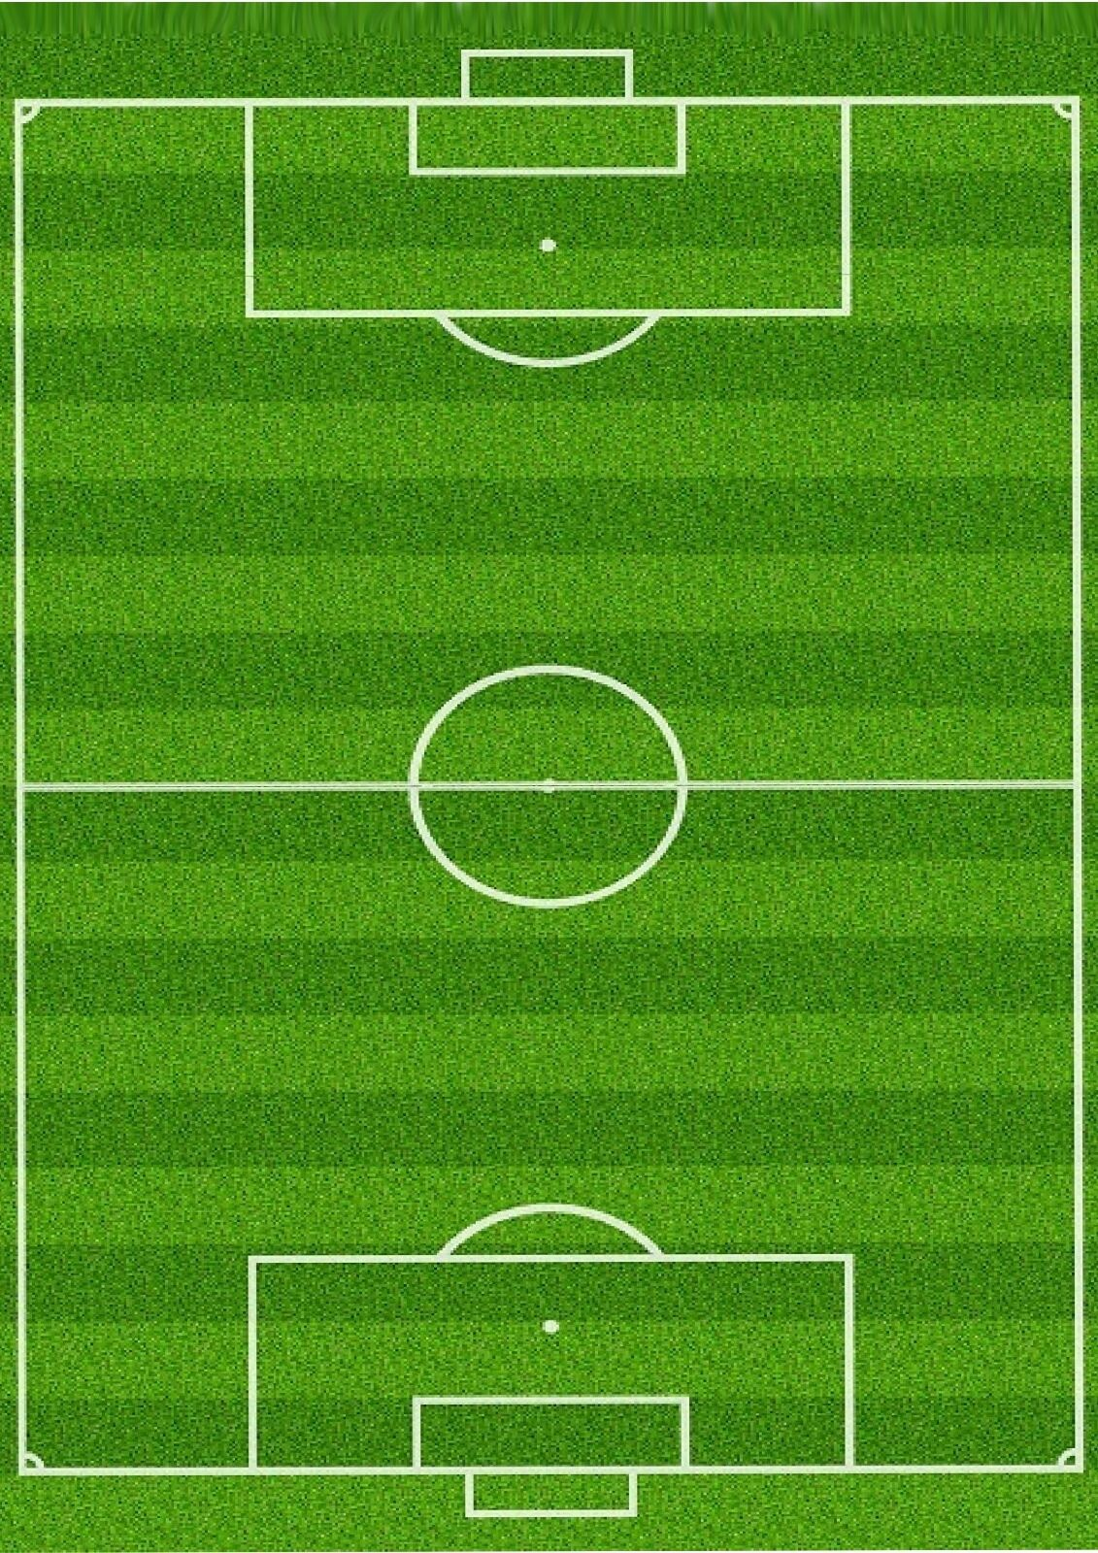
ERSDA 5, 7 & 9 a side Pitch Set-up
Minimising the potential for touchline issues with an agreed set-up
Team 1 Supporters
Team 1 Supporters
Before kick-off, each team takes an end of the pitch for all their coaches, subs and supporters.
It is up to coaches to instruct their supporters where they should stand. If there is a cage or barrier, supporters should remain behind it, outside the playing area.
Where there is no barrier or cage, supporters must be 2m back from the edge of the pitch and not directly behind the goal.
The only exception is where accessibility needs or pitch facilities do not allow this … in this case supporters should be as close to 2m back from the pitch as possible
Both sides have a technical area which, for simplicity, is one half of the pitch, from the halfway line to the goal line.
Each team should have a different half of the pitch for their technical area for the whole game.
Coaches and substitutes must stay in their technical area, and supporters are not permitted to enter the technical area.
First aiders may enter the field of play during a game to administer first aid if required.
At no point during the game should any coach or supporter enter the field of play, or the opposition technical or supporter area.
2m
cage or barrier if available
Team 1
Attacking this way ↓
Team 1 Technical Area
Team 2 Technical Area
Team 2
Attacking this way ↑
cage or barrier if available
2m
This guidance is based on an SFA best practice design. Teams are encouraged to collaborate in applying common sense to good pitch set up.
Team 2 Supporters
Team 2 Supporters

Slide 14

Support from Matchday Coordinators
Matchday officials to help things run smoothly
Matchday Coordinators are officials provided by our partners, East Renfrewshire Culture and Leisure (ERCL). They will be easily identifiable at venues and play a vital role in ensuring the smooth running of matchdays.
Role & Responsibilities
The primary aim of the Matchday Coordinator role is to:
Support the delivery of ERSDA small-sided football opportunities for all.
Ensure a fun, safe, and educational environment for all participants.
Support & Guidance
Coaches, supporters, and players are welcome to approach Matchday Coordinators with questions about game formats or venue setups.
They will observe proceedings, providing feedback and advice to support the smooth flow of games.
Specific Duties
For 4 and 5-a-side games, Matchday Coordinators will manage the timing, using a hooter or whistle to signal the start and end of game time.
They will complete matchday reports, similar to referees, and are required to report any incidents or issues.
They may also highlight positive examples of good sporting conduct!
Respect for Matchday Coordinators
We ask that players, coaches, and supporters treat Matchday Coordinators as match officials, as defined by the SYFA, showing respect for them and their instructions on matchday.

Slide 15
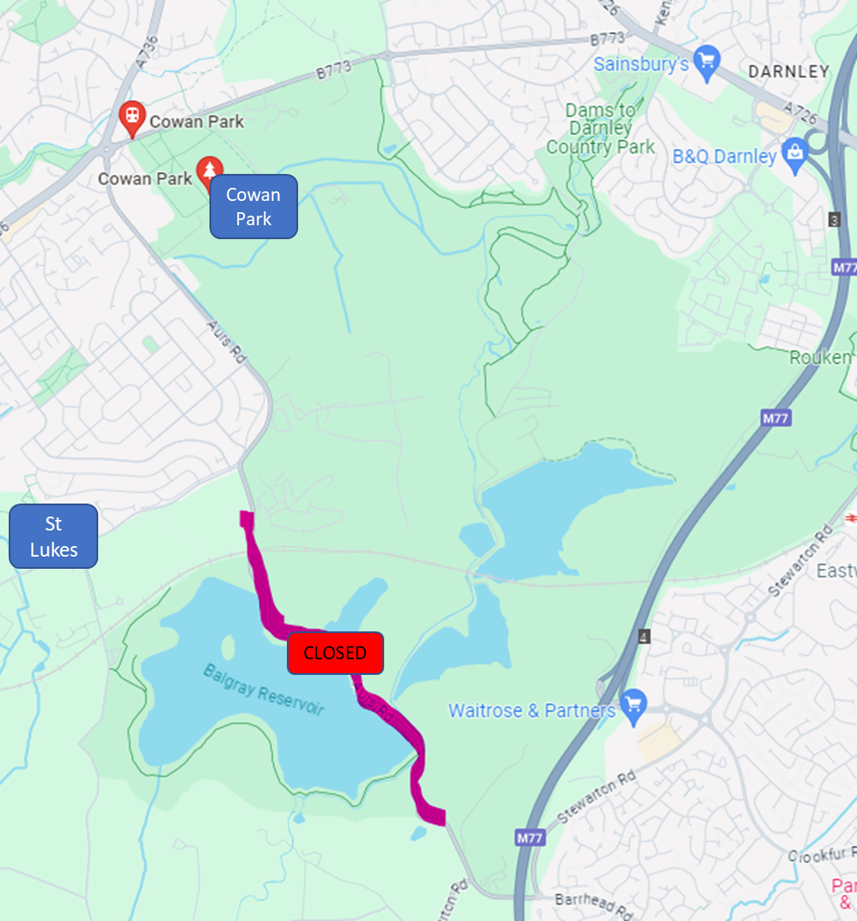
Managing Matchday Logistics
🗓️ Saturday or Sunday Fixtures
Boys/Mixed Game Fixtures: Saturday only
Girls Game Fixtures: Sunday only
Playing weekends and holiday weekends will be the same for all teams
🚧 Road Closure Alert: Plan Additional Journey Time
The Aurs Road at Darnley Dams will be closed until Summer 2026.
Please allow extra travel time when attending Cowan Park and St Luke’s venues.
🟢 Grass Pitches: Setting Up & Taking Down Goals
First teams on the pitch:Retrieve goal equipment from the goal store and set up prior to the match (ideally one set of goals per team)
Last teams off the pitch:Take down goals and return equipment to the goal store.
Time management:Allow at least 15 minutes for setup and takedown.
Pro Tip:Ask specific parents to help, rather than a general call-out, to ensure support.
⚽Bring Your Own Footballs
Match balls are not provided at games.Please check the National Player Pathway page for the correct ball size for your age group.Each team should bring footballs for warm-up and potential match use.
💷 Referee Match Fee (9-a-side games)
For 9-a-side matches, a referee fee of £36 applies (split between the teams).The fee should be paid directly to the referee before kick-off.
🚑 Touchline Team Requirements
Follow SYFA playing rules (Section 22.2) for touchline representation of coaches and first aiders.
If sharing first-aid representation, ensure first-aiders know and agree to arrangements before match activities begin.
📲 Ensure WhatsApp Group Representation
Every matchday, make sure your team is represented in the age group WhatsApp group. The group will also include Fixture Coordinators and Matchday Coordinators

Slide 16
Game Format
The National Player Journey

Slide 17
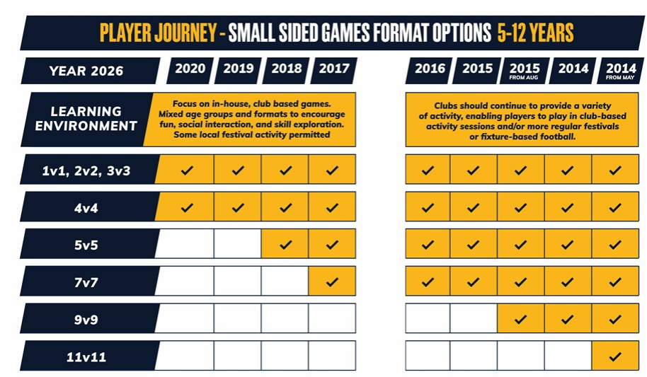
National Player Journey - Formats
Game standards and formats
The SFA outline in detail how the game should be played before 11-a-side.
They define the player journey opposite. This is how we organize the age groups at ERSDA.
The following pages give the detailed rules that govern the different playing formats. They should be followed exactly in small-sided fixtures.
For more information and resources on this, visit:
https://www.scottishfa.co.uk/football-development/participation/childrens-youth-football/player-journey/

Slide 18
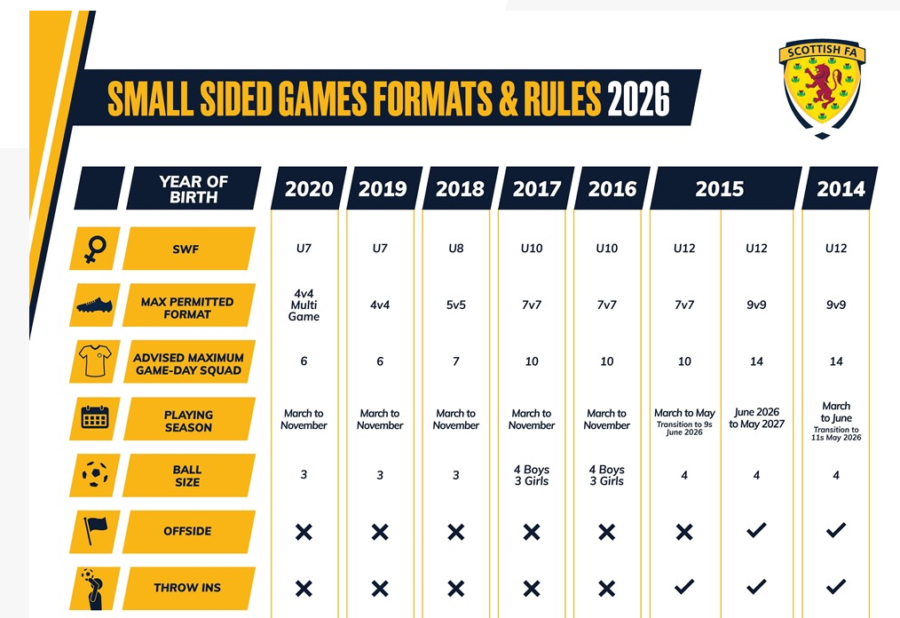
National Player Journey (1/3)
Game standards and formats
The national player journey is how the SFA asks us to run the game. This table is a summary of the rules and guidelines for each age group.
Note, the Girls game organises by different age groups to the Boys/Mixed game
For more information and resources on the journey, please follow the link below:
https://www.scottishfa.co.uk/football-development/participation/childrens-youth-football/player-journey/

Slide 19

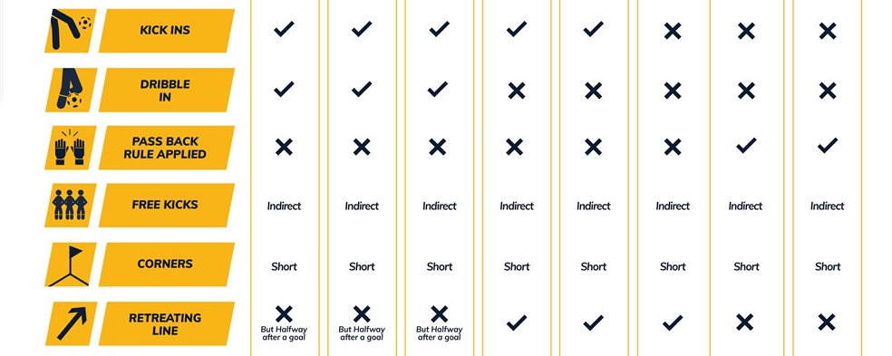
National Player Journey (2/3)
Game standards and formats
The national player journey is how the SFA asks us to run the game. This table is a summary of the rules and guidelines for each age group.
Note, the Girls game organises by different age groups to the Boys/Mixed game
For more information and resources on the journey, please follow the link below:
https://www.scottishfa.co.uk/football-development/participation/childrens-youth-football/player-journey/

Slide 20

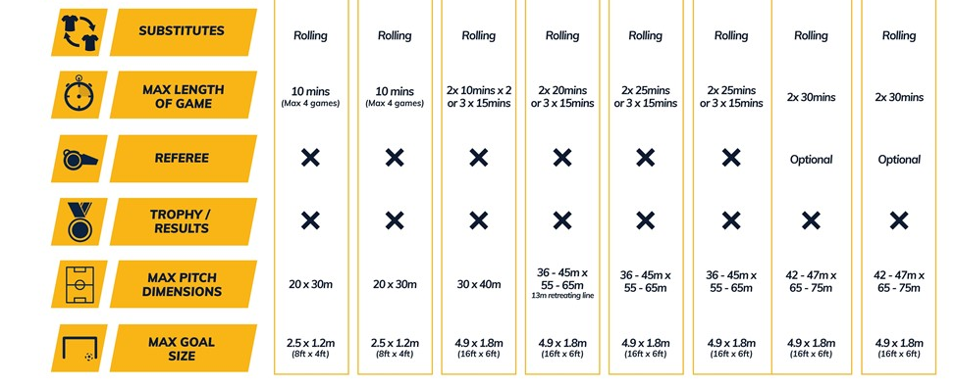
National Player Journey (3/3)
Game standards and formats
The national player journey is how the SFA asks us to run the game. This table is a summary of the rules and guidelines for each age group.
Note, the Girls game organises by different age groups to the Boys/Mixed game
For more information and resources on the journey, please follow the link below:
https://www.scottishfa.co.uk/football-development/participation/childrens-youth-football/player-journey/

